Slide 1


Reactivitis :
A Chronic Condition of Industry
November 2023

Slide 2
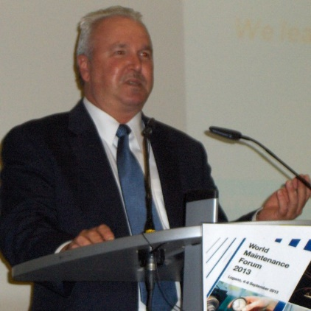
The Author
Mark Broussard – President & CEO
Education
  BSME from University of Louisiana Lafayette (85)
  MBA Studies Louisiana State University (92)
Industry Experience
  Aerospace - Pratt & Whitney – Maintenance Engineer (85)
  Chemical – ICI Chemical/Rubicon – Maintenance Engineer (90)
  Research & Development – General Dynamics –Reliability Engineer (92)
  Automotive – Stewart & Stevenson – Reliability Manager (94)
  EPC - Fluor Engineering – Reliability Manager (95)
Consulting Experience
  Fluor Corporation – Managing Director (97)
  Day & Zimmerman – Business Development Executive (00)
  Independent – Consulting Manager (01)
  SAMI – Progression from Consulting Manager (02) to President & CEO (Current)

Slide 3
Disclaimer
The use of any / all medical terms is for illustrative analogy purposes only. No medical professionals were involved or consulted to validate proper application or usage of any medical terminology.

Slide 4

REACTIVITIS
A chronic condition of organizational reactivity affecting the health of industrial assets globally to varying degrees
A Medical Analogy Discussion of Organizational Reactivity

Slide 5
Patient Profile
Industry : All (Descending Prevalence: Mining, Metals, Petrochemical, Chemical, Oil & Gas, Automotive, Aerospace)
Scale : Any, Affects Large, Medium, and Small Operations Equally
Age : Any, Typically Greater Than 5 Years
Region : Any, Condition Exists Globally
Economic Status : Higher Prevalence in Profitable Enterprises
Cultural Status : Personality Driven, Variable Behaviors
Recent Interventions : Variable
No Industrial Enterprise or Organization is Immune

Slide 6
Symptoms
Low / Declining Asset Availability : Maintenance Related Losses Increasing
High Emergent Work : Priority 1 (Emergency) Work Dominates Activity
Low Productivity : Efficiency Barriers Abound
Poor Housekeeping : Viewed as Low Priority
Increasing Costs : Maintenance Costs Rising Fiscal Year Over Year
Communications Issues : Barriers Between Functional Organizations
Insufficient Documentation : Lack of Structure and Role Definition
Insufficient Measurement : Lack of Meaningful Performance Metrics
Increasing Variability : Rapidly Changing Priorities

Slide 7
Severity & Condition Scale
CONDITION
Stable
Critical
0
5
10
15
20
25
30
35 >
Controlled
Mild
Moderate
Severe
Uncontrolled
SEVERITY
Percentage of Emergent Maintenance Work Versus Total

Slide 8

Diagnosis
Two Organizational Levels of Diagnosis
  Patient (Enterprise)
  System (Functional / Organizational)
Enterprise Evaluation
  High Level Examination of Key Health Elements by Domain (Enabling, Benefit)
Functional / Organizational Evaluation
  Granular Examination of Symptoms / Causes (Processes, People, Tools)
  Data Driven Quantification of Impacts (Losses, Value)
Reactivity Root Cause Diagnosis Dependent on Documentation & Data Quality

Slide 9
Enterprise Level Evaluation
Four Domains With Three Key Elements Each to Evaluate Health

Slide 10
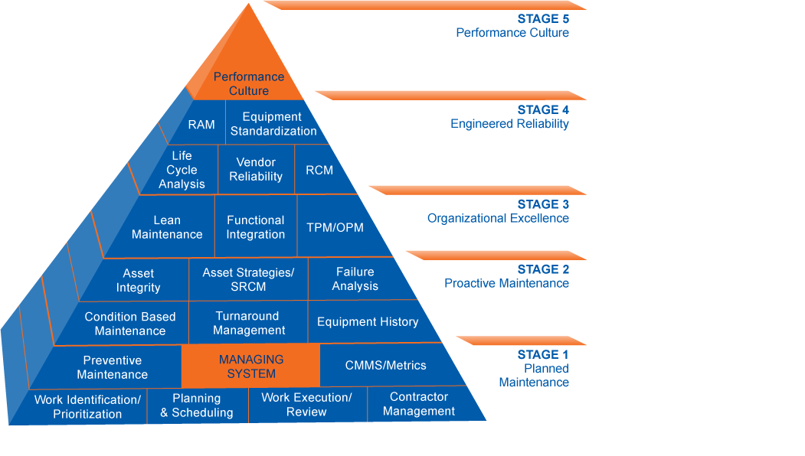
Functional Evaluation of the Maintenance System
Asset Healthcare Model of Processes & Best Practices

Slide 11
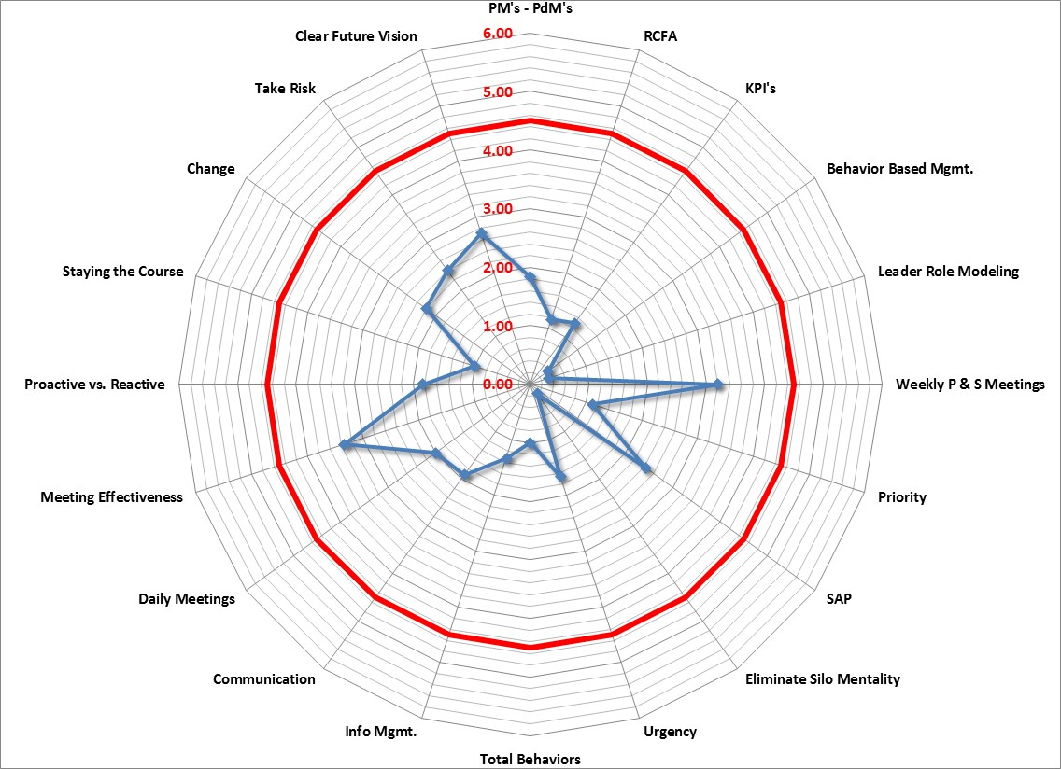
Functional Behaviors Dictate Performance

Slide 12

Comorbidities
Low / No Risk Profile : Operationally Risk Averse
Low Equipment Reliability : Assets at End of Useful Life
Operating Deviations : Exceeding Design Envelope or Capacity
Organizational Silos : Rigid Functional Boundaries
Blame Culture : No Accountability
These Issues Can Exacerbate Reactivity and Mask Root Causes

Slide 13
Patient Impacts
Lower Production Volumes : Availability Impacts, Variability Impacts
Higher Operating Expense : Efficiency, Productivity, and Logistics Impacts
Lower Earnings : Regardless of Market Influences
Cultural Instability : Low Morale, No Predictability
Staff Turnover : Frustration, Burn Out
Reactivitis Destroys Economic Value for the Enterprise

Slide 14
Treatment Plans
Acknowledgement : Recognize and Acknowledge the Condition Exists
Self Diagnosis : Evaluate the Severity of the Condition, Isolate to the System
Assessment : Functional Evaluation of Symptoms, Define Root Cause
Design : Develop Treatment Plan (Document Functional Process, Role Responsibilities, Metrics, and Behaviors)
Install : Execute Treatment Plan (Implement Revisions to Control Condition & Severity)
Sustain : Monitor Health Progress (Coach Improvement to Sustainability)
Certify : Measure Improvement, Recognize Success and Achievement
Treatments Plans are Tailored for Each Enterprise

Slide 15
Stable Status with Controlled Condition
Functional Behaviors Support Sustained Controlled Condition

Slide 16

Critical Success Factors
Self Awareness : Identify the Dysfunction (Leadership)
Obtain Help : External Intervention to Support & Confirm Diagnosis
Treatment : Follow the Plan (Discipline), No Self-Medication
Monitoring : Measure and Adjust (Accountability)
Long Term Care : Monitor and Refine (Continuous Improvement)
Reactivitis Can Be Controlled and Impacts Minimized Over Time

Slide 17


Questions /
Comments
Contact : info@samicorp.com

