Slide 1
The Reactive Power of 1
October 2024

Slide 2
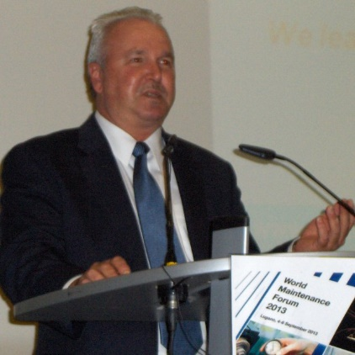
The Author
Mark Broussard – President & CEO
Education
BSME from University of Louisiana Lafayette (85)
MBA Studies Louisiana State University (92)
Industry Experience
Aerospace - Pratt & Whitney – Maintenance Engineer (85)
Chemical – ICI Chemical/Rubicon – Maintenance Engineer (90)
Research & Development – General Dynamics –Reliability Engineer (92)
Automotive – Stewart & Stevenson – Reliability Manager (94)
EPC - Fluor Engineering – Reliability Manager (95)
Consulting Experience
Fluor Corporation – Managing Director (97)
Day & Zimmerman – Business Development Executive (00)
Independent – Consulting Manager (01)
SAMI – Progression from Consulting Manager (02) to President & CEO (Current)

Slide 3
Presenting Issue
“Why can one individual inject and sustain organizational reactivity?”

Slide 4
Organizational Culture Analysis : Assumptions
Operating Entity
Independent
Homogenous
Solitary
Integrated
Static

Slide 5
Macro-Cultural Forces
Operating Entity
Chronemic
Geopolitical
Regional
Societal

Slide 6
Chronemic Forces
Monochronic
Polychronic
Linear View
Sequential Focus
Singular, Small, Precise Events
Order
Activity Focus
Time as Distinct Product
Less Solidified
Non-Sequential
Multiple, Large, Fluid Events
Change Oriented
Relationship Focus
Promptness Less Vital

Slide 7
Core-Cultural Forces
Corporate Functions
Affiliates
Competitive
Political
Governance
Technical
Economic
Entity Underlying Structure

Slide 8
Micro-Cultural Forces
Business Functions
Leadership
Procedural
Peer Pressure
Risk Aversion
Functional
Behavioral
Affiliate Underlying Structure

Slide 9
Cultural Forces
Forces are pervasive throughout the entity
Influences on each & every individual
Represent pathways for variability & reactivity
Technical (Core Functions)
Behavioral (All Functions / Roles)
Communication (All Directions)
Cultural forces can be controlled and transformed
Perspective on value of time is limiting dimension

Slide 10
Ancient Proverb¹
For Want of a Nail
For want of a nail the shoe was lost.
For want of a shoe the horse was lost.
For want of a horse the rider was lost.
For want of a rider the message was lost.
For want of a message the battle was lost.
For want of a battle the kingdom was lost.
And all for the want of a horseshoe nail.
1 – Anonymous (Oldest versions attributed to Friedank c.1230)

Slide 11
Asset Management Analogy
For Want of a P3
Routine work order prioritized as P1
Emergent work defers critical equipment PM
Critical equipment failure causes extended outage
Product deliveries significantly delayed
Key customers depart
Affiliate’s business contracts
Entity loses profits or worse
And all for the want of a P3 priority
Priority 1
Confirmed

Slide 12
Reactive Culture Development
For Want of a P3
Occasional occurrence – Low probability
Routine occurrence creates a pattern
Pattern becomes a habit
Habit becomes accepted behavior
Behavior embeds in the culture over time
Reactivity is sustained by the culture
Probability of undesired outcome is high

Slide 13
Reactivity Mitigation
Forces must be mitigated from Micro outward to Macro
Ability to influence Core & Macro forces diminishes
Focus on the individual roles
Training (Technical & Social Competency)
Coaching (Behavioral Compliance)
Communication (Coordination & Synchronization)
Fortify core functions
Managing System Governance (Accountability, Role Definition)
Measurement & Reporting (Visibility, Rewards, Communication)
Leadership (Vision Clarity, Values, Continuous Improvement Focus)

Slide 14
Reactivity Mitigation (continued)
Reactivity can be controlled but not eliminated
Transformation efforts must be targeted and structured
Technical (Functional Focus)
Managing System (Operating Rhythm Focus)
Change Management (Behavioral Focus)
Leadership Commitment (Time, Resources & Visible Support)
Transformation is not a one and done effort
Cultural Forces Do Not Abate (Variable But Always Present)
Organizational Culture is Dynamic (Turnover, Weakest Link)
Sustainability Takes Time (Simple, But Not Easy!)

Slide 15
The Reactive Power of 1
PRO
RE
ACTIVITY
The Transformative Challenge We Face!

Slide 16
Questions / Comments
Contact : info@samicorp.com

